Slide 1


财务分析——地产巨鳄的“战争”
招商地产VS保利地产
指导老师：吴世农 教授
小组成员：
邓 萍 雷 鸣 林宗魁 王润山
温跃华 谢凌芳 谢志强 杨俊先
（排名不分先后）

Slide 2
大纲
一、公司概况
二、主要财务数据
三、财务指标的“三维”分析
四、收益、风险、成长和价值创造的分解分析
五、财务政策评价和比较分析
六、总体建议

Slide 3
一、公司概况：
招商地产：
招商局地产控股股份有限公司于1984年在深圳成立，是香港招商局集团三大核心产业之一的地产业旗舰公司，也是中国最早的房地产公司之一，先后在深圳交易所（000024）、新加坡交易所（200024）挂牌上市。
经过20多年的发展，招商地产已成为一家集开发、物业管理有机配合、物业品种齐全的房地产业集团，形成了以深圳为核心，以珠三角、长三角和环渤海经济带为重点经营区域的市场格局。

Slide 4
一、公司概况：
保利地产：
保利房地产（集团）股份有限公司1983年12月成立，是中国保利集团控股的大型国有房地产企业。2006年7月31日，公司股票在上海证券交易所挂牌上市，经营范围是房地产开发、销售、租赁及其物业管理。
截至到2009年末保利南方集团有限公司以44.36％的比例具有控股权。保利地产业务以北京、上海、广州、武汉、沈阳、长沙为主，在全国都具有竞争实力。

Slide 5
大纲
一、公司概况
二、主要财务数据
三、财务指标的“三维”分析
四、收益、风险、成长和价值创造的分解分析
五、财务政策评价和比较分析
六、总体建议

Slide 6
二、主要财务数据-招商地产
表1：招商地产2005年～2009年主要财务数据（单位：元）
财务数据 | 2005 | 2006 | 2007 | 2008 | 2009
营业总收入 | 2,750,690,000 | 2,809,280,000 | 4,111,640,000 | 3,573,180,000 | 10,137,700,000
营业成本 | 1,972,520,000 | 1,750,940,000 | 2,179,150,000 | 2,097,770,000 | 5,961,740,000
销售费用 | 53,840,800 | 77,892,100 | 76,214,800 | 226,716,000 | 285,335,000
管理费用 | 95,040,800 | 119,511,000 | 160,772,000 | 203,224,000 | 208,543,000
财务费用 | (2,273,030) | 10,728,500 | 10,604,600 | 30,913,600 | (15,356,000)
营业利润 | 547,854,000 | 755,849,000 | 1,327,210,000 | 1,290,210,000 | 2,274,640,000
EBIT | 575,850,970 | 801,572,500 | 1,465,044,600 | 1,332,773,600 | 2,258,374,000
EBITDA | 575,850,970 | 879,330,583 | 1,555,346,606 | 1,463,008,522 | 2,441,214,300
税前利润 | 578,124,000 | 790,844,000 | 1,454,440,000 | 1,301,860,000 | 2,273,730,000
税后利润 | 473,803,000 | 662,914,000 | 1,195,130,000 | 1,092,000,000 | 1,754,470,000
（1－T） | 82.0% | 83.8% | 82.2% | 83.9% | 77.2%
总资产 | 8,254,464,393 | 10,269,315,000 | 18,795,950,000 | 31,272,100,000 | 42,667,100,000
流动资产 | 5,882,585,238 | 8,035,095,000 | 15,861,950,000 | 27,081,550,000 | 37,566,800,000
现金，存款和有价证券 | 370,198,226 | 671,858,138 | 2,296,426,013 | 5,537,281,000 | 8,491,194,740
应收款 | 208,754,013 | 419,584,751 | 747,794,350 | 889,537,350 | 1,465,578,500
预付款 | 391,865 | 1,875,594 | 5,155,135 | 17,806,035 | 18,532,105
存货 | 5,301,276,026 | 6,929,020,000 | 12,796,065,000 | 20,518,300,000 | 27,165,250,000
长期资产 | 1,469,843,739 | 2,234,245,000 | 2,933,995,000 | 4,190,525,000 | 5,100,305,000
总负债 | 4,937,128,737 | 6,889,265,000 | 12,384,335,000 | 18,559,950,000 | 25,376,300,000
流动负债 | 4,162,710,579 | 4,209,560,000 | 8,632,425,000 | 13,249,950,000 | 18,965,350,000
短期贷款 | 1,648,470,709 | 1,678,610,000 | 3,736,280,000 | 4,642,745,000 | 2,493,445,000
应付款 | 2,216,835,637 | 2,128,654,295 | 4,066,830,045 | 5,632,245,540 | 7,642,443,190
预收款 | 269,288,771 | 311,973,800 | 364,609,500 | 1,457,262,000 | 6,114,965,000
长期负债 | 774,418,158 | 2,679,705,000 | 3,751,940,000 | 5,310,025,000 | 6,410,935,000
长期贷款 | 756,783,158 | 1,940,000,000 | 3,007,615,000 | 5,226,275,000 | 6,263,810,000
有息负债 | 2,406,472,032 | 3,632,243,265 | 6,770,705,450 | 9,900,058,050 | 8,797,132,550
所有者权益 | 3,266,480,136 | 3,380,065,000 | 6,411,600,000 | 12,712,120,000 | 17,290,750,000
投入资本 | 5,672,952,168 | 7,012,308,265 | 13,182,305,450 | 22,612,178,050 | 26,087,882,550
经营净现金 | (1,373,910,000) | (1,582,810,000) | (4,002,590,000) | (3,919,840,000) | 7,054,730,000
筹资净现金 | 1,343,020,000 | 2,449,800,000 | 8,195,730,000 | 8,164,450,000 | (5,189,140,000)
投资净现金 | (61,575,900) | (254,264,000) | (1,561,230,000) | (419,241,000) | (445,789,000)
当年现金增减 |  | 614,081,000 | 2,625,580,000 | 3,813,070,000 | 1,417,600,000
年末现金余额 |  | 919,406,000 | 3,544,980,000 | 7,358,060,000 | 8,775,660,000

Slide 7
二、主要财务数据-保利地产
表2：保利地产2005年～2009年主要财务数据（单位：元）
财务数据 | 2005 | 2006 | 2007 | 2008 | 2009
营业总收入 | 2,364,540,000 | 4,031,210,000 | 8,115,230,000 | 15,519,900,000 | 22,986,600,000
营业成本 | 1,356,160,000 | 2,587,130,000 | 4,991,100,000 | 9,188,230,000 | 14,524,100,000
销售费用 | 105,061,000 | 168,302,000 | 255,596,000 | 462,403,000 | 590,781,000
管理费用 | 79,125,000 | 104,394,000 | 208,206,000 | 311,208,000 | 456,717,000
财务费用 | 2,586,550 | (6,874,050) | (31,933,800) | (33,216,400) | (66,172,900)
营业利润 | 643,133,000 | 1,054,030,000 | 2,053,850,000 | 3,836,810,000 | 5,220,300,000
EBIT | 645,125,550 | 1,043,585,950 | 2,371,156,200 | 3,990,063,600 | 5,312,877,100
EBITDA | 645,125,550 | 1,055,555,050 | 2,389,544,000 | 4,014,055,000 | 5,364,554,000
税前利润 | 642,539,000 | 1,050,460,000 | 2,403,090,000 | 4,023,280,000 | 5,379,050,000
税后利润 | 411,057,000 | 733,946,000 | 1,628,270,000 | 3,043,670,000 | 4,007,730,000
（1－T） | 64.0% | 69.9% | 67.8% | 75.7% | 74.5%
总资产 | 6,116,469,420 | 12,261,185,000 | 28,701,300,000 | 47,263,450,000 | 71,731,450,000
流动资产 | 6,042,475,160 | 12,068,455,000 | 28,432,650,000 | 46,916,650,000 | 70,857,700,000
现金，存款和有价证券 | 486,700,555 | 818,310,100 | 2,774,588,715 | 5,049,172,652 | 10,349,190,677
应收款 | 368,215,999 | 859,055,400 | 1,334,295,182 | 1,047,901,282 | 759,021,500
预付款 | 626,707,210 | 1,698,410,000 | 4,649,195,000 | 6,679,620,000 | 9,602,215,000
存货 | 4,560,679,476 | 8,692,675,000 | 19,674,600,000 | 34,140,000,000 | 50,147,250,000
长期资产 | 60,380,500 | 192,736,000 | 268,620,500 | 346,727,000 | 873,742,000
总负债 | 5,123,165,700 | 9,651,025,000 | 20,274,850,000 | 33,009,600,000 | 50,414,100,000
流动负债 | 3,984,272,413 | 7,231,010,000 | 13,886,745,000 | 19,212,450,000 | 28,874,150,000
短期贷款 | 2,074,000,000 | 5,045,000,000 | 6,365,545,000 | 3,125,545,000 | 189,010,000
应付款 | 1,618,548,496 | 2,607,482,960 | 3,760,358,710 | 5,126,453,450 | 4,903,299,750
预收款 | 1,425,107,406 | 3,461,995,000 | 7,931,140,000 | 10,369,220,000 | 19,814,470,000
长期负债 | 1,137,405,000 | 2,420,020,000 | 6,388,110,000 | 13,797,145,000 | 21,539,950,000
长期贷款 | 1,135,980,000 | 2,416,430,000 | 6,330,025,000 | 11,543,325,000 | 17,149,150,000
有息负债 | 3,209,980,000 | 7,461,430,000 | 12,695,570,000 | 16,795,195,000 | 21,595,425,000
所有者权益 | 886,179,213 | 2,610,145,000 | 8,426,435,000 | 14,253,800,000 | 21,317,300,000
投入资本 | 4,096,159,213 | 10,071,575,000 | 21,122,005,000 | 31,048,995,000 | 42,912,725,000
经营净现金 | (836,852,000) | (4,021,860,000) | (9,375,800,000) | (7,590,470,000) | (1,144,790,000)
筹资净现金 | 1,391,050,000 | 4,443,670,000 | 1,319,860,000 | 8,496,020,000 | 11,305,900,000
投资净现金 | (97,939,400) | (215,691,000) | (117,272,000) | (61,820,500) | (402,910,000)
当年现金增减 | -- | 206,118,000 | 3,705,520,000 | 843,768,000 | 9,758,150,000
年末现金余额 | -- | 920,470,000 | 4,625,990,000 | 5,469,760,000 | 15,227,900,000

Slide 8
大纲
一、公司概况
二、主要财务数据
三、财务指标的“三维”分析
四、收益、风险、成长和价值创造的分解分析
五、财务政策评价和比较分析
六、总体建议

Slide 9
三、财务指标的“三维”分析
表3：招商地产盈利能力－历史比较分析（单位：元）
财务指标 | 2005 | 2006 | 2007 | 2008 | 2009
销售净利率 | 17.2% | 23.6% | 29.1% | 30.6% | 17.3%
ROA | 7.0% | 7.8% | 7.8% | 4.3% | 5.3%
ROE | 14.5% | 19.6% | 18.6% | 8.6% | 10.1%
招商地产从2005、2006、2007年销售净利率、ROA、ROE指标均呈稳定上升或基本稳定，但是从2008年到2009年三大指标的跳水，可以看出，招商在这两年内不断扩充资本所带来的利润却在下降，这与2008年的全球金融危机以及2008年国家实施房地产行业宏观调控有关。但仍能保持17%的净利率，说明总体上招商的盈利能力是很不错的。

Slide 10
三、财务指标的“三维”分析
表4：保利地产盈利能力－历史比较分析（单位：元）
财务指标 | 2005 | 2006 | 2007 | 2008 | 2009
销售净利率 | 17.4% | 18.2% | 20.1% | 19.6% | 17.4%
ROA | 10.5% | 8.5% | 8.3% | 8.4% | 7.4%
ROE | 46.4% | 28.1% | 19.3% | 21.4% | 18.8%
从五年的数据看，保利的利润率和回报率基本稳定，在2008和2009年仍没有较大变动，说明保利的盈利能力较强。尤其在2008年公司实现了销售业绩逆市上涨，销售金额205.11亿元，表现出相当强的盈利能力。

Slide 11
三、财务指标的“三维”分析
表5：招商地产负债能力－历史比较分析（单位：元）
财务指标 | 2005 | 2006 | 2007 | 2008 | 2009
流动比率 | 1.7687 | 1.8934 | 1.7641 | 2.2856 | 1.7981
速动比率 | 0.1176 | 0.2293 | 0.3663 | 0.6068 | 0.5134
资产负债率(%) | 56.4853 | 68.3299 | 63.5771 | 56.5149 | 61.7889
长期负债比率(%) | 18.0059 | 27.8002 | 14.5187 | 18.1834 | 11.9429
负债与所有者权益比率(%) | 133.691 | 223.6904 | 174.5529 | 129.9641 | 161.704
1、招商地产的流动比率、速动比率指标上，2008年为五年最高，其他年份基本稳定。
2、由于房地产行业的特殊性，资产负债率总体较高，但招商地产基本能控制在行业水平70%以内，说明其资产负债比例较为安全。

Slide 12
三、财务指标的“三维”分析
表6：保利地产负债能力－历史比较分析（单位：元）
财务指标 | 2005 | 2006 | 2007 | 2008 | 2009
流动比率 | 1.4136 | 1.8369 | 2.1482 | 2.7267 | 2.3148
速动比率 | 0.3165 | 0.5615 | 0.663 | 0.667 | 0.7429
资产负债率(%) | 84.9907 | 75.7115 | 68.6158 | 70.7766 | 69.9863
长期负债比率(%) | 15.1078 | 21.9562 | 22.101 | 26.1941 | 22.5422
负债与所有者权益比率(%) | 716.8675 | 344.3651 | 218.6315 | 242.1915 | 233.1809
1、保利地产流动比率和速动比率稳步上升，其短期偿债能力较强且稳定。
2、资产负债率略有下降，但相对平稳，说明保利虽然负债增加，资产负债了保持在70%左右，处于较为合理的水平，长期负债能力有所增强。

Slide 13
三、财务指标的“三维”分析
表7：招商地产资产周转能力－历史比较分析（单位：元）
财务指标 | 2005 | 2006 | 2007 | 2008 | 2009
应收账款周转率(次) | 52.0235 | 104.222 | 85.2113 | 43.6615 | 89.6583
存货周转率(次) | 0.3559 | 0.24 | 0.1703 | 0.1022 | 0.2195
固定资产周转率(次) | 4.3782 | 4.8449 | 10.5907 | 12.4561 | 34.7069
总资产周转率(次) | 0.3058 | 0.2541 | 0.2188 | 0.1143 | 0.2376
1、招商地产的应收帐款周转率2006年高达104次，而除了2008年以外四年的应收账款周转情况相对稳定，说明应收账款回收情况较好。2008年受到金融危机及国家宏观调控的影响，应收款回收较慢。
2、存货周转率和总资产周转率在2007年和2008年相对较低，其他年份均稳定。说明招商地产总体资产的运作情况良好。

Slide 14
三、财务指标的“三维”分析
表8：保利地产资产周转能力－历史比较分析（单位：元）
财务指标 | 2005 | 2006 | 2007 | 2008 | 2009
应收账款周转率(次) | 16.509 | 23.9782 | 45.7578 | 81.5126 | 68.352
存货周转率(次) | 0.2961 | 0.2965 | 0.2537 | 0.2691 | 0.2896
固定资产周转率(次) | 122.2914 | 120.2287 | 88.8405 | 94.105 | 116.4245
总资产周转率(次) | 0.3852 | 0.3286 | 0.2827 | 0.3284 | 0.3205
1、保利地产的应收账款周转率一直呈快速上升阶段，到2009年稍微下降，而存货周转率保持到0.29次左右，相对稳定。
2、固定资产周转率和总资产周转率则呈小幅下降后回升的状态。说明其资产周转的能力相当好。

Slide 15
三、财务指标的“三维”分析
表9：招商地产成长能力－历史比较分析（单位：元）
财务指标 | 2005 | 2006 | 2007 | 2008 | 2009
主营业务收入增长率(%) | -23.4881 | 10.5256 | 46.3596 | -13.096 | 183.7162
净利润增长率(%) | 17.17 | 34.7102 | 80.2845 | -8.6292 | 60.6654
净资产增长率(%) | 9.4013 | 14.8958 | 148.6024 | 78.0204 | 12.4238
总资产增长率(%) | 5.6956 | 58.9184 | 101.1029 | 49.1089 | 27.9407
招商地产除了2008年的主营业务收入增长率、净利润增长率出现回落外，2005年到2009年各项增长率稳定上升。说明其成长能力较好。

Slide 16
三、财务指标的“三维”分析
表10：保利地产成长能力－历史比较分析（单位：元）
财务指标 | 2005 | 2006 | 2007 | 2008 | 2009
主营业务收入增长率(%) | 51.1423 | 70.9044 | 101.31 | 91.244 | 48.1105
净利润增长率(%) | 115.1583 | 61.9212 | 121.8515 | 86.9267 | 31.6741
净资产增长率(%) | 66.5915 | 281.6464 | 219.3947 | 22.1176 | 72.0239
总资产增长率(%) | 90.009 | 105.8026 | 147.728 | 31.1471 | 67.4941
保利地产在2005到2009年各项指标快速上升，其中2006－2007年净资产、总资产增幅很大。说明期间其资产规模迅速扩大。

Slide 17
“三维”分析--行业比较
表11：2009年盈利能力指标行业比较
 | 招商 | 保利 | 万科
总资产利润率(%) | 3.663 | 4.4614 | 4.6727
销售净利率(%) | 17.3063 | 17.4351 | 13.1544
净资产报酬率(%) | 11.8176 | 15.1241 | 15.0151
1、ROA、ROE：保利、万科高于招商；保利与万科持平。说明保利的资产使用情况比招商好。
2、销售净利率：招商与保利持平，均高于万科4个百分点以上。可见，2009年保利总体盈利能力高于招商。
1、从主营业务收入增长率和净利润增长率两项指标看，招商的成长能力远高于保利；
2、净资产增长率、总资产增长率指标上，招商低于保利，归因于招商负债少，资产规模扩大幅度小。保利的投资规模要大于招商。
表12：2009年成长能力指标行业比较
 | 招商 | 保利 | 万科
主营业务收入增长率(%) | 183.7162 | 48.1105 | 19.2459
净利润增长率(%) | 60.6654 | 31.6741 | 38.5817
净资产增长率(%) | 12.4238 | 72.0239 | 16.9763
总资产增长率(%) | 27.9407 | 67.4941 | 15.408

Slide 18
“三维”分析--行业比较
表13：2009营运能力指标行业比较
 | 招商 | 保利 | 万科
应收账款周转率(次) | 89.6583 | 68.352 | 59.758
存货周转率(次) | 0.2195 | 0.2896 | 0.3922
固定资产周转率(次) | 34.7069 | 116.4245 | 37.2951
总资产周转率(次) | 0.2376 | 0.3205 | 0.3806
1、招商的应收账款周转率远远高于保利与万科，说明其应收账款回收快，但其存货周转相对较慢，存货流动性差，销售形势不如其他两者。
2、固定资产周转率指标上，保利远远高于万科和招商。招商的总资产周转率低于保利和万科，说明其资产使用和管理能力较差。
表14：2009年偿债能力指标行业比较
 | 招商 | 保利 | 万科
流动比率(%) | 1.7981 | 2.3148 | 1.9149
速动比率(%) | 0.5134 | 0.7429 | 0.5912
资产负债率(%) | 61.7889 | 69.9863 | 67.0017
招商的资产负债率较保利和万科低，而且流动比率、速动比率均低于保利和万科，说明2009年招商资产流动性比保利差。

Slide 19
“三维”分析—构成比较
招商的短期借款项目从2005年占总资产的20%下降14.2个百分点到2009年占5.8%，而预收款由3.3%上升11个百分点达到14.3%。这说明招商有可能在2009年通过预售楼花增加预收账款减少短期负债。
表15：招商地产资产负债表结构比例
 | 单位（元） |  |  |  |  | 结构比（％）
报表日期 | 2005 | 2006 | 2007 | 2008 | 2009 | 2005 | 2006 | 2007 | 2008 | 2009
流动资产
货币资金 | 368,054,101 | 669,623,000 | 2,296,335,000 | 5,488,615,000 | 8,439,310,000 | 4.5% | 6.5% | 12.2% | 17.6% | 19.8%
应收账款 | 69,247,404 | 51,782,100 | 48,252,350 | 81,838,350 | 113,070,500 | 0.8% | 0.5% | 0.3% | 0.3% | 0.3%
流动资产合计 | 5,882,585,236 | 8,035,095,000 | 15,861,950,000 | 27,081,550,000 | 37,566,800,000 | 71.3% | 78.2% | 84.4% | 86.6% | 88.0%
非流动资产 | 0 | 0 | 0 | 0 | 0
长期应收款 | 593,327,398 | 0 | 0 | 485,980,000 | 1,017,055,000 | 7.2% | 0.0% | 0.0% | 1.6% | 2.4%
投资性房地产 | 605,255,000 | 1,416,085,000 | 1,999,670,000 | 2,505,330,000 | 2,710,410,000 | 7.3% | 13.8% | 10.6% | 8.0% | 6.4%
固定资产净额 | 547,055,041 | 484,624,000 | 385,434,500 | 286,863,000 | 292,095,000 | 6.6% | 4.7% | 2.1% | 0.9% | 0.7%
非流动资产合计 | 1,469,843,739 | 2,234,245,000 | 2,933,995,000 | 4,190,525,000 | 5,100,305,000 | 17.8% | 21.8% | 15.6% | 13.4% | 12.0%
资产总计 | 8,254,464,393 | 10,269,315,000 | 18,795,950,000 | 31,272,100,000 | 42,667,100,000 | 100.0% | 100.0% | 100.0% | 100.0% | 100.0%
流动负债 | 0 | 0 | 0 | 0 | 0 | 0.0% | 0.0% | 0.0% | 0.0% | 0.0%
短期借款 | 1,648,470,709 | 1,678,610,000 | 3,736,280,000 | 4,642,745,000 | 2,493,445,000 | 20.0% | 16.3% | 19.9% | 14.8% | 5.8%
应付账款 | 1,280,122,065 | 1,020,441,500 | 2,045,210,000 | 2,390,275,000 | 2,284,605,000 | 15.5% | 9.9% | 10.9% | 7.6% | 5.4%
预收款项 | 269,288,771 | 311,973,800 | 364,609,500 | 1,457,262,000 | 6,114,965,000 | 3.3% | 3.0% | 1.9% | 4.7% | 14.3%
其他应付款 | 603,137,843 | 541,699,500 | 1,376,659,000 | 2,647,080,000 | 4,494,950,000 | 7.3% | 5.3% | 7.3% | 8.5% | 10.5%
流动负债合计 | 4,162,710,579 | 4,209,560,000 | 8,632,425,000 | 13,249,950,000 | 18,965,350,000 | 50.4% | 41.0% | 45.9% | 42.4% | 44.4%
非流动负债 | 0 | 0 | 0 | 0 | 0 | 0.0% | 0.0% | 0.0% | 0.0% | 0.0%
长期借款 | 756,783,158 | 1,940,000,000 | 3,007,615,000 | 5,226,275,000 | 6,263,810,000 | 9.2% | 18.9% | 16.0% | 16.7% | 14.7%
非流动负债合计 | 774,418,158 | 2,679,705,000 | 3,751,940,000 | 5,310,025,000 | 6,410,935,000 | 9.4% | 26.1% | 20.0% | 17.0% | 15.0%
负债合计 | 4,937,128,737 | 6,889,265,000 | 12,384,335,000 | 18,559,950,000 | 25,376,300,000 | 59.8% | 67.1% | 65.9% | 59.3% | 59.5%
所有者权益 | 0 | 0 | 0 | 0 | 0 | 0.0% | 0.0% | 0.0% | 0.0% | 0.0%
实收资本(或股本) | 618,822,836 | 618,823,000 | 731,845,000 | 1,281,083,500 | 1,717,300,000 | 7.5% | 6.0% | 3.9% | 4.1% | 4.0%
未分配利润 | 1,120,636,930 | 1,842,080,000 | 2,582,885,000 | 3,442,320,000 | 4,536,485,000 | 13.6% | 17.9% | 13.7% | 11.0% | 10.6%
所有者权益(或股东权益)合计 | 3,266,480,136 | 3,380,065,000 | 6,411,600,000 | 12,712,120,000 | 17,290,750,000 | 39.6% | 32.9% | 34.1% | 40.7% | 40.5%
负债和所有者权益总计 | 8,254,464,393 | 10,269,315,000 | 18,795,950,000 | 31,272,100,000 | 42,667,100,000 | 100.0% | 100.0% | 100.0% | 100.0% | 100.0%

Slide 20
“三维”分析—构成比较
表16：招商地产利润表结构分析
 | 单位（元） |  |  |  |  | 结构（％） |  |  |  |  | 增长（％）
报表日期 | 2005 | 2006 | 2007 | 2008 | 2009 | 2005 | 2006 | 2007 | 2008 | 2009 | 06/05 增长率 | 07/06 增长率 | 08/07 增长率 | 09/08 增长率
一、营业总收入 | 2750690000 | 2809280000 | 4111640000 | 3573180000 | 10137700000 | 100.0% | 100.0% | 100.0% | 100.0% | 100.0% | 2.1% | 46.4% | -13.1% | 183.7%
营业收入 | 2750690000 | 2809280000 | 4111640000 | 3573180000 | 10137700000 | 100.0% | 100.0% | 100.0% | 100.0% | 100.0% | 2.1% | 46.4% | -13.1% | 183.7%
二、营业总成本 | 2226440000 | 2143690000 | 2934910000 | 3231260000 | 8063970000 | 80.9% | 76.3% | 71.4% | 90.4% | 79.5% | -3.7% | 36.9% | 10.1% | 149.6%
营业成本 | 1972520000 | 1750940000 | 2179150000 | 2097770000 | 5961740000 | 71.7% | 62.3% | 53.0% | 58.7% | 58.8% | -11.2% | 24.5% | -3.7% | 184.2%
营业税金及附加 | 105953000 | 183534000 | 512845000 | 264980000 | 1623220000 | 3.9% | 6.5% | 12.5% | 7.4% | 16.0% | 73.2% | 179.4% | -48.3% | 512.6%
销售费用 | 53840800 | 77892100 | 76214800 | 226716000 | 285335000 | 2.0% | 2.8% | 1.9% | 6.3% | 2.8% | 44.7% | -2.2% | 197.5% | 25.9%
管理费用 | 95040800 | 119511000 | 160772000 | 203224000 | 208543000 | 3.5% | 4.3% | 3.9% | 5.7% | 2.1% | 25.7% | 34.5% | 26.4% | 2.6%
财务费用 | (2273030) | 10728500 | 10604600 | 30913600 | (15356000) | -0.1% | 0.4% | 0.3% | 0.9% | -0.2% | -572.0% | -1.2% | 191.5% | -149.7%
资产减值损失 | 1358820 | 1083400 | (4678990) | 407655000 | 484187 | 0.0% | 0.0% | -0.1% | 11.4% | 0.0% | -20.3% | -531.9% | -8812.5% | -99.9%
投资收益 | 19312700 | 92927300 | 201065000 | 802815000 | 304570000 | 0.7% | 3.3% | 4.9% | 22.5% | 3.0% | 381.2% | 116.4% | 299.3% | -62.1%
三、营业利润 | 547854000 | 755849000 | 1327210000 | 1290210000 | 2274640000 | 19.9% | 26.9% | 32.3% | 36.1% | 22.4% | 38.0% | 75.6% | -2.8% | 76.3%
利润总额 | 578124000 | 790844000 | 1454440000 | 1301860000 | 2273730000 | 21.0% | 28.2% | 35.4% | 36.4% | 22.4% | 36.8% | 83.9% | -10.5% | 74.7%
所得税费用 | 104321000 | 127930000 | 259309000 | 209865000 | 519264000 | 3.8% | 4.6% | 6.3% | 5.9% | 5.1% | 22.6% | 102.7% | -19.1% | 147.4%
四、净利润 | 473803000 | 662914000 | 1195130000 | 1092000000 | 1754470000 | 17.2% | 23.6% | 29.1% | 30.6% | 17.3% | 39.9% | 80.3% | -8.6% | 60.7%

Slide 21
“三维”分析—构成比较
表17：保利地产资产负债表结构比例
 | 单位（元） |  |  |  |  | 结构比（％）
报表日期 | 2005 | 2006 | 2007 | 2008 | 2009 | 2005 | 2006 | 2007 | 2008 | 2009
流动资产
货币资金 | 486,223,195 | 817,411,000 | 2,773,230,000 | 5,047,875,000 | 10,348,830,000 | 7.9% | 6.7% | 9.7% | 10.7% | 14.4%
预付款项 | 626,707,210 | 1,698,410,000 | 4,649,195,000 | 6,679,620,000 | 9,602,215,000 | 10.2% | 13.9% | 16.2% | 14.1% | 13.4%
存货 | 4,560,679,476 | 8,692,675,000 | 19,674,600,000 | 34,140,000,000 | 50,147,250,000 | 74.6% | 70.9% | 68.5% | 72.2% | 69.9%
流动资产合计 | 6,042,475,160 | 12,068,455,000 | 28,432,650,000 | 46,916,650,000 | 70,857,700,000 | 98.8% | 98.4% | 99.1% | 99.3% | 98.8%
非流动资产 | 0 | 0 | 0 | 0 | 0 | 0.0% | 0.0% | 0.0% | 0.0% | 0.0%
非流动资产合计 | 60,380,500 | 192,736,000 | 268,620,500 | 346,727,000 | 873,742,000 | 1.0% | 1.6% | 0.9% | 0.7% | 1.2%
资产总计 | 6,116,469,420 | 12,261,185,000 | 28,701,300,000 | 47,263,450,000 | 71,731,450,000 | 100.0% | 100.0% | 100.0% | 100.0% | 100.0%
流动负债 | 0 | 0 | 0 | 0 | 0 | 0.0% | 0.0% | 0.0% | 0.0% | 0.0%
短期借款 | 2,074,000,000 | 5,045,000,000 | 6,365,545,000 | 3,125,545,000 | 189,010,000 | 33.9% | 41.1% | 22.2% | 6.6% | 0.3%
应付账款 | 153,763,468 | 218,375,500 | 665,514,000 | 1,763,740,000 | 2,567,745,000 | 2.5% | 1.8% | 2.3% | 3.7% | 3.6%
预收款项 | 1,425,107,406 | 3,461,995,000 | 7,931,140,000 | 10,369,220,000 | 19,814,470,000 | 23.3% | 28.2% | 27.6% | 21.9% | 27.6%
其他应付款 | 1,355,341,665 | 2,320,565,000 | 3,212,525,000 | 3,566,595,000 | 2,774,955,000 | 22.2% | 18.9% | 11.2% | 7.5% | 3.9%
流动负债合计 | 3,984,272,413 | 7,231,010,000 | 13,886,745,000 | 19,212,450,000 | 28,874,150,000 | 65.1% | 59.0% | 48.4% | 40.6% | 40.3%
非流动负债 | 0 | 0 | 0 | 0 | 0 | 0.0% | 0.0% | 0.0% | 0.0% | 0.0%
长期借款 | 1,135,980,000 | 2,416,430,000 | 6,330,025,000 | 11,543,325,000 | 17,149,150,000 | 18.6% | 19.7% | 22.1% | 24.4% | 23.9%
非流动负债合计 | 1,137,405,000 | 2,420,020,000 | 6,388,110,000 | 13,797,145,000 | 21,539,950,000 | 18.6% | 19.7% | 22.3% | 29.2% | 30.0%
负债合计 | 5,123,165,700 | 9,651,025,000 | 20,274,850,000 | 33,009,600,000 | 50,414,100,000 | 83.8% | 78.7% | 70.6% | 69.8% | 70.3%
所有者权益 | 0 | 0 | 0 | 0 | 0 | 0.0% | 0.0% | 0.0% | 0.0% | 0.0%
实收资本(或股本) | 300,000,000 | 475,000,000 | 888,085,000 | 1,839,255,000 | 2,986,030,000 | 4.9% | 3.9% | 3.1% | 3.9% | 4.2%
未分配利润 | 319,375,986 | 721,921,500 | 1,744,670,000 | 3,519,880,000 | 5,720,690,000 | 5.2% | 5.9% | 6.1% | 7.4% | 8.0%
所有者权益(或股东权益)合计 | 886,179,213 | 2,610,145,000 | 8,426,435,000 | 14,253,800,000 | 21,317,300,000 | 14.5% | 21.3% | 29.4% | 30.2% | 29.7%
负债和所有者权益(或股东权益)总计 | 6,116,469,420 | 12,261,185,000 | 28,701,300,000 | 47,263,450,000 | 71,731,450,000 | 100.0% | 100.0% | 100.0% | 100.0% | 100.0%
2005－2009年，短期负债比重逐年下降，而非流动负债比重逐年上升。说明保利地产调整负债结构。

Slide 22
“三维”分析—构成比较
1、公司07年实现营业收入81.15亿元，同比增长101.31％，主要来源于期内房屋销售量及销售均价的上升；净利润为14.89亿元，同比增长121.77％，净利润增长高于营业收入增长主要是期内营业外收入大幅增加所致。
 | 表18：保利地产利润表结构分析
 | 单位（元） |  |  |  |  | 结构（％）
报表日期 | 2005 | 2006 | 2007 | 2008 | 2009 | 2005 | 2006 | 2007 | 2008 | 2009
一、营业总收入 | 2,364,540,000 | 4,031,210,000 | 8,115,230,000 | 15,519,900,000 | 22,986,600,000 | 100.0% | 100.0% | 100.0% | 100.0% | 100.0%
营业收入 | 2,364,540,000 | 4,031,210,000 | 8,115,230,000 | 15,519,900,000 | 22,986,600,000 | 100.0% | 100.0% | 100.0% | 100.0% | 100.0%
二、营业总成本 | 1,707,860,000 | 3,179,550,000 | 6,269,880,000 | 11,779,000,000 | 17,767,700,000 | 72.2% | 78.9% | 77.3% | 75.9% | 77.3%
营业成本 | 1,356,160,000 | 2,587,130,000 | 4,991,100,000 | 9,188,230,000 | 14,524,100,000 | 57.4% | 64.2% | 61.5% | 59.2% | 63.2%
营业税金及附加 | 155,173,000 | 315,452,000 | 839,493,000 | 1,545,960,000 | 2,536,430,000 | 6.6% | 7.8% | 10.3% | 10.0% | 11.0%
销售费用 | 105,061,000 | 168,302,000 | 255,596,000 | 462,403,000 | 590,781,000 | 4.4% | 4.2% | 3.1% | 3.0% | 2.6%
管理费用 | 79,125,000 | 104,394,000 | 208,206,000 | 311,208,000 | 456,717,000 | 3.3% | 2.6% | 2.6% | 2.0% | 2.0%
财务费用 | 2,586,550 | -6,874,050 | -31,933,800 | -33,216,400 | -66,172,900 | 0.1% | -0.2% | -0.4% | -0.2% | -0.3%
资产减值损失 | 9,751,840 | 11,142,400 | 7,420,670 | 304,445,000 | -274,064,000 | 0.4% | 0.3% | 0.1% | 2.0% | -1.2%
投资收益 | -13,291,500 | 202,479,000 | 207,461,000 | 97,089,700 | 1,632,860 | -0.6% | 5.0% | 2.6% | 0.6% | 0.0%
三、营业利润 | 643,133,000 | 1,054,030,000 | 2,053,850,000 | 3,836,810,000 | 5,220,300,000 | 27.2% | 26.1% | 25.3% | 24.7% | 22.7%
营业外收入 | 1,675,410 | 1,439,710 | 355,752,000 | 196,853,000 | 194,738,000 | 0.1% | 0.0% | 4.4% | 1.3% | 0.8%
营业外支出 | 2,268,900 | 5,007,190 | 6,508,600 | 10,376,700 | 35,992,800 | 0.1% | 0.1% | 0.1% | 0.1% | 0.2%
利润总额 | 642,539,000 | 1,050,460,000 | 2,403,090,000 | 4,023,280,000 | 5,379,050,000 | 27.2% | 26.1% | 29.6% | 25.9% | 23.4%
所得税费用 | 231,482,000 | 316,519,000 | 774,820,000 | 979,613,000 | 1,371,320,000 | 9.8% | 7.9% | 9.5% | 6.3% | 6.0%
四、净利润 | 411,057,000 | 733,946,000 | 1,628,270,000 | 3,043,670,000 | 4,007,730,000 | 17.4% | 18.2% | 20.1% | 19.6% | 17.4%
归属于母公司所有者的净利润 | 400,327,000 | 671,456,000 | 1,489,090,000 | 2,238,860,000 | 3,519,230,000 | 16.9% | 16.7% | 18.3% | 14.4% | 15.3%
少数股东损益 | 10,729,900 | 62,490,200 | 139,182,000 | 804,810,000 | 488,501,000 | 0.5% | 1.6% | 1.7% | 5.2% | 2.1%
2、2007年营业外收入增长了122倍，主要是因为自期内会计准则调整带来的2.5亿元和北京政泉项目补偿款带来的1亿元；2009年营业外支出增长1.3倍，主要也是用于投资活动。

Slide 23
“三维”分析—构成比较
表19：保利地产现金流量表结构分析（万元）
报告期 | 2005-12-31 | 2006-12-31 | 2007-12-31 | 2008-12-31 | 2009-12-31 | 06/05 增长率 | 07/06 增长率 | 08/07 增长率 | 09/08 增长率
经营活动产生的现金流量净额 | -83685.2 | -402186 | -937580 | -759047 | -114479 | 380.6% | 133.1% | -19.0% | -84.9%
投资活动产生的现金流量净额 | -9793.94 | -21569.1 | -11727.2 | -6182.05 | -40291 | 120.2% | -45.6% | -47.3% | 551.7%
筹资活动产生的现金流量净额 | 139105 | 444367 | 1319860 | 849602 | 1130590 | 219.4% | 197.0% | -35.6% | 33.1%
现金及现金等价物净增加值 | 45625.86 | 20611.9 | 370552.8 | 84372.95 | 975820
总现金流为正，经营性、投资性现金流均为负，但是筹资性现金流为正，说明保利2005－2009年一直通过筹资活动维持资金链条运转。

Slide 24
大纲
一、公司概况
二、主要财务数据
三、财务指标的“三维”分析
四、收益、风险、成长和价值创造的分解分析
五、财务政策评价和比较分析
六、总体建议

Slide 25
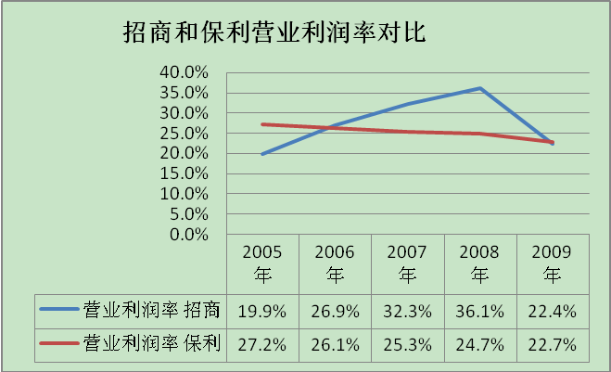
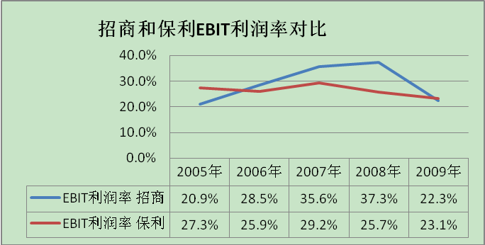
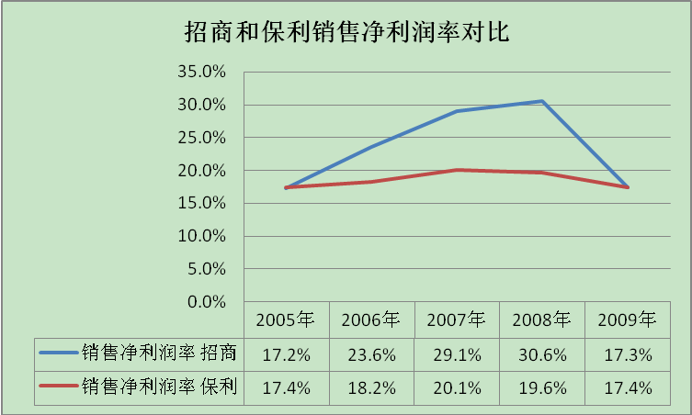
四、收益、风险、成长和价值创造的分解分析
1、盈利能力比较分析：

Slide 26
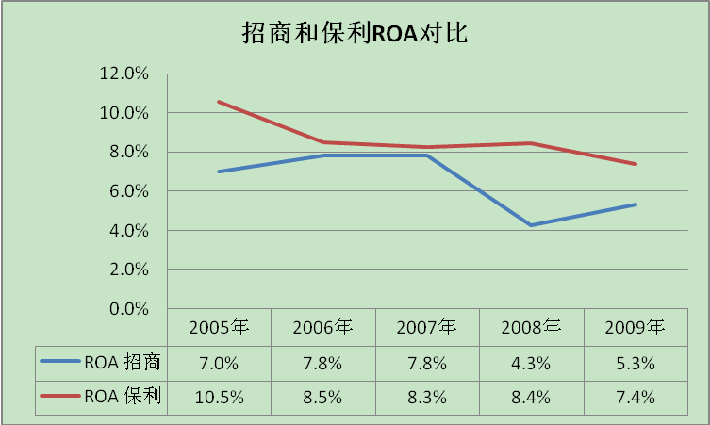
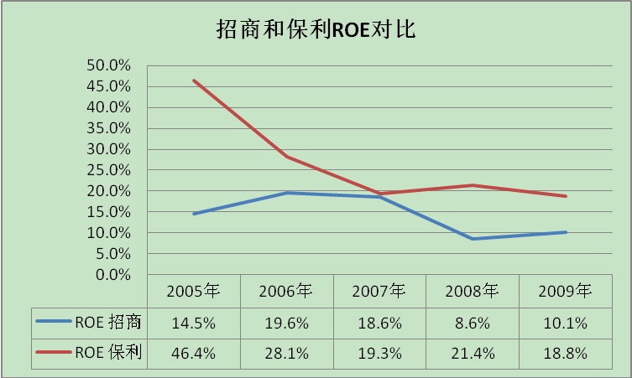
盈利能力的分析结论：
从主要盈利能力指标看，2005～2008年招商地产和保利地产的盈利能力均处于增强趋势。但是2008～2009年开始出现下降趋势。
从销售盈利能力看，尽管2008年出现下降趋势，但招商地产总体上比保利地产强。从资产和资本盈利能力看，尽管2005～2009年期间，两家公司的资产和资本盈利能力都处于减弱趋势，但保利地产相对较强些。
主要原因：2008年盈利能力呈现下降趋势的主要原因应归结为当年国家对房地产行业采取了宏观调控政策，使房地产行业2008～2009年整体景气度下滑。

Slide 27
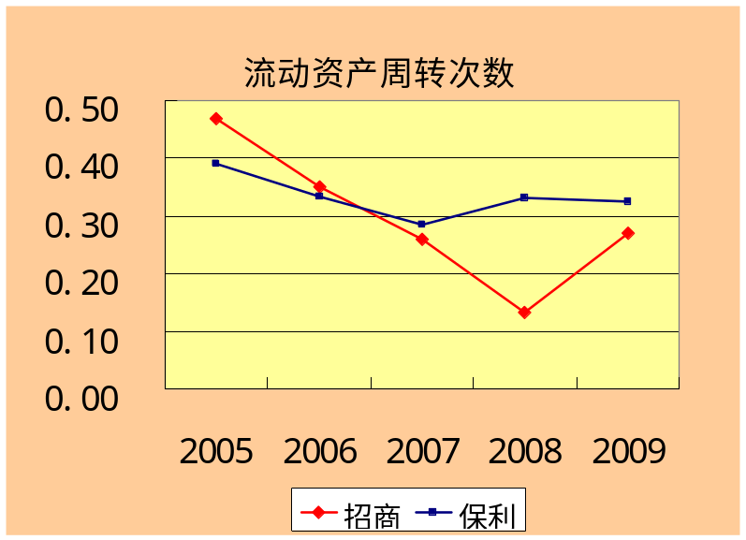
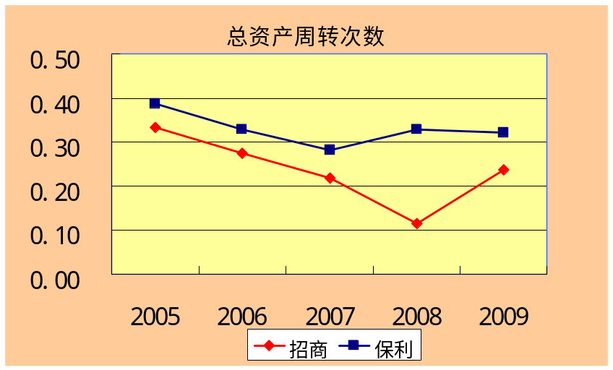
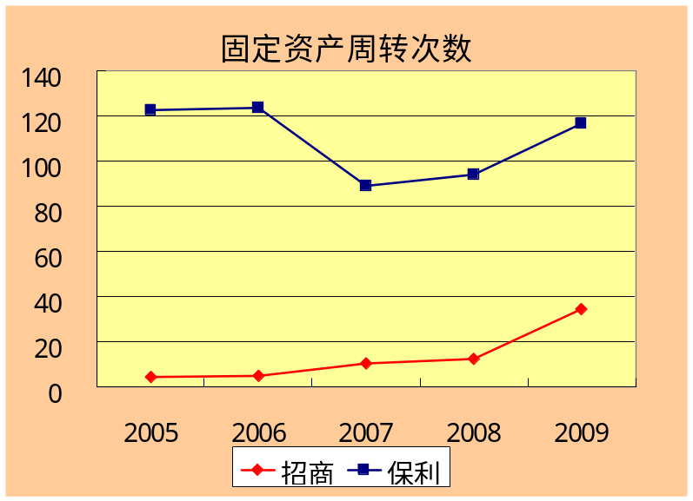
四、收益、风险、成长和价值创造的分解分析
2、资产使用效率比较分析：

Slide 28
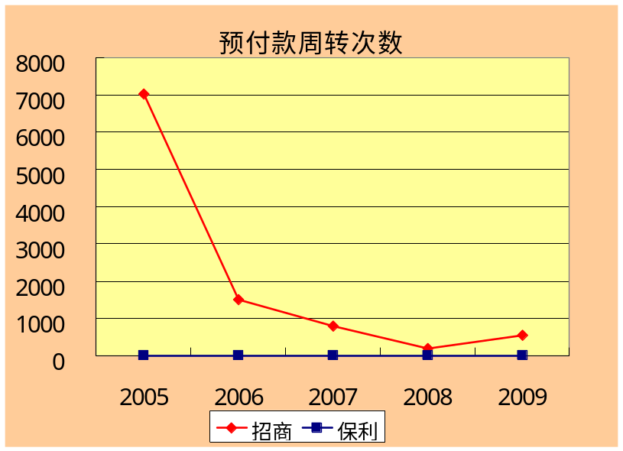
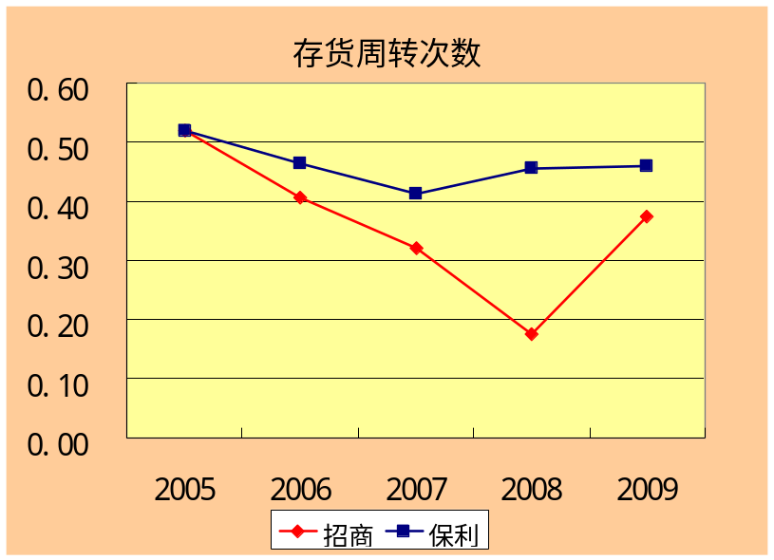
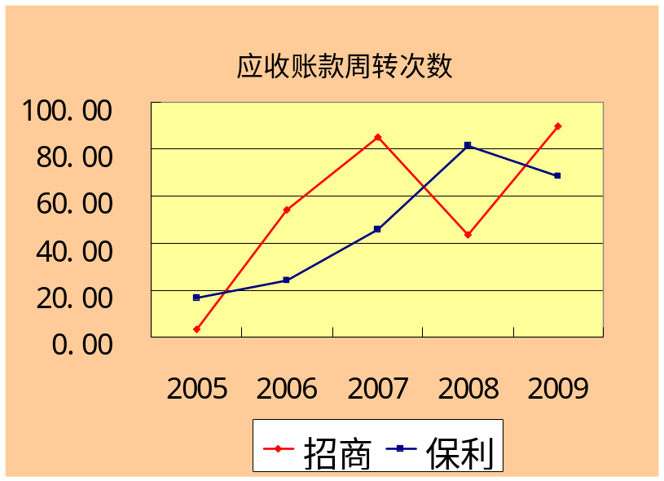
四、收益、风险、成长和价值创造的分解分析
从总体看，两家公司资产利用率都处于下降后小幅上涨的趋势，但从波动幅度的大小、回调速度的快慢可以看出保利地产的资产使用效率高于招商地产。在投入资本使用上，两家公司都采取了有效措施，提高了使用效率，招商地产的预付款管理效率显著高于保利地产。

Slide 29
四、收益、风险、成长和价值创造的分解分析
从图表中可以看出，资产使用效率大幅变化基本都出现在2008年，总资产周转率、流动资产周转率、应收账款周转率、存货周转率分别在2008年出现大幅跳水。
分析其主要原因在于：
（1）2008年，国民经济运行的内外部环境复杂多变。上半年将“防经济过热、防通货膨胀”确定为宏观调控的主要目标，下半年及调整为“保持经济平稳快速增长”。
（2）随着国内外经济环境的剧烈变化，房地产行业自身与国民经济高相关度和对资金高依赖度的特点，导致行业步入了全局性的深度的量缩价跌和资金困境下的投资减少。资金方面遭遇销售萎缩和融资渠道收紧的双重压力。通过预收款及定金方式筹集的资金大幅下降，自筹方式资金上涨。

Slide 30
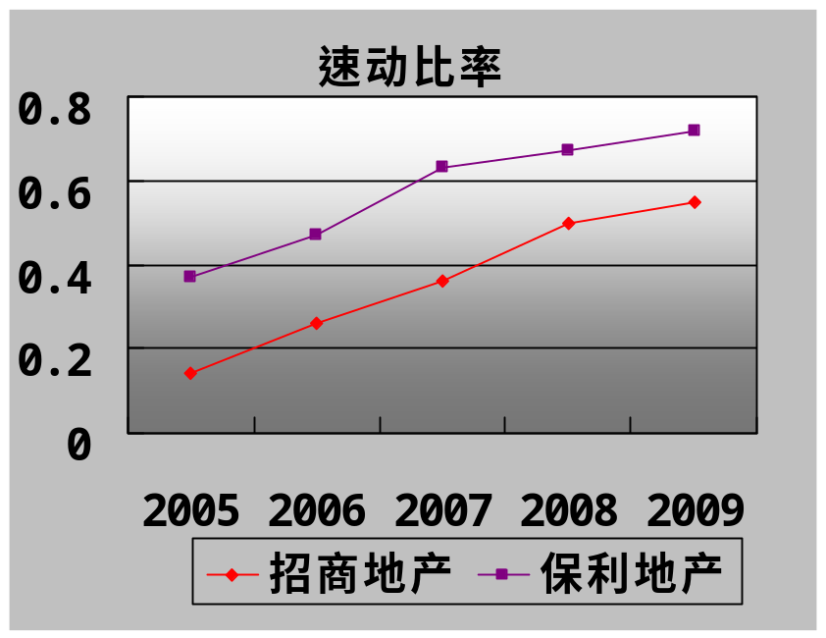
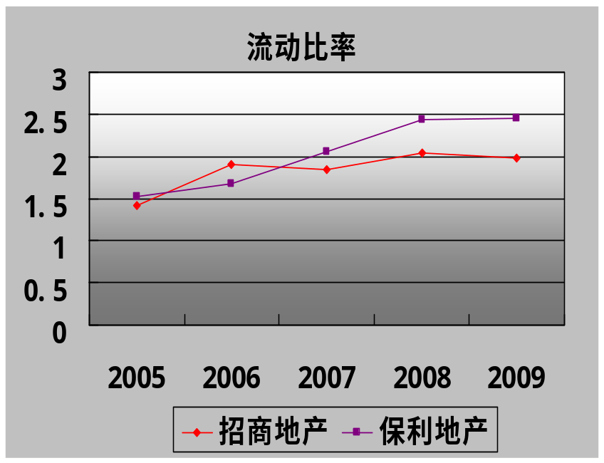
四、收益、风险、成长和价值创造的分解分析
3、负债管理分析：

Slide 31
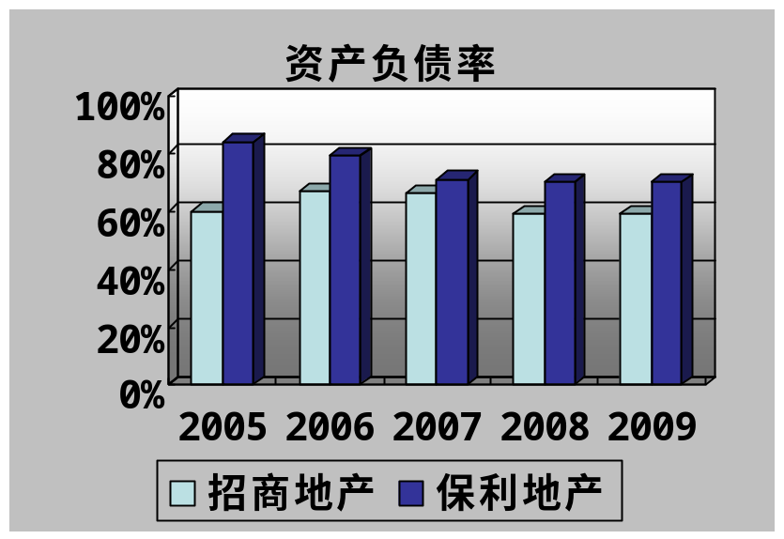
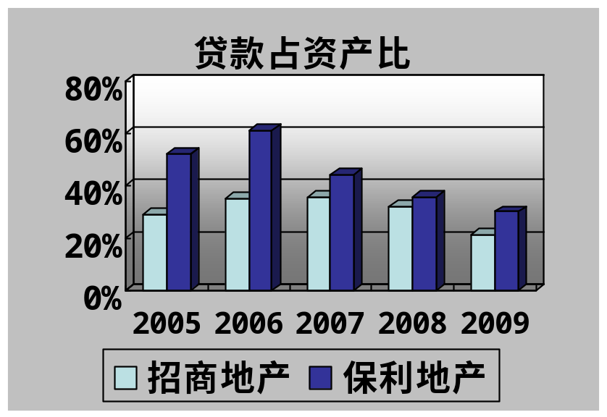
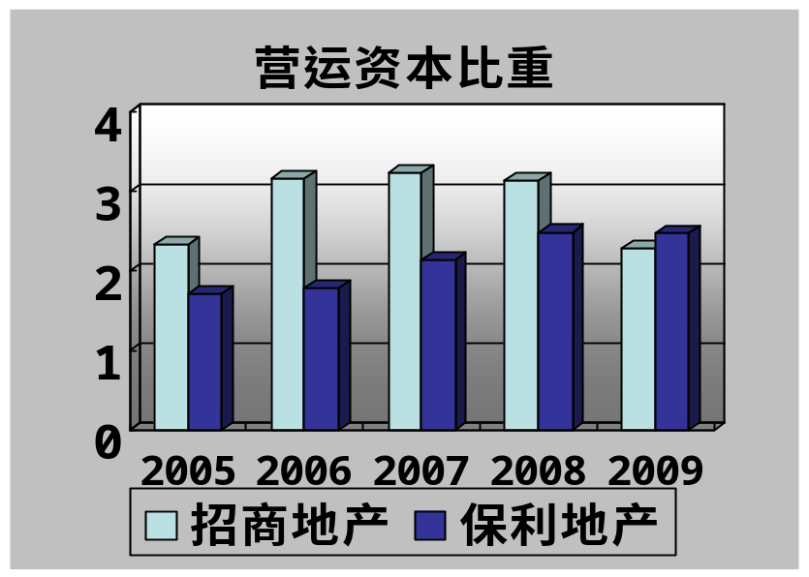
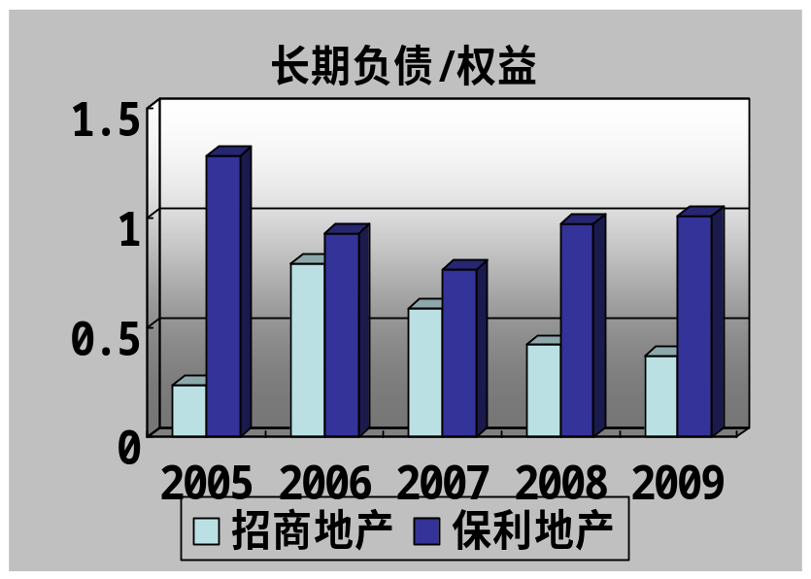
四、收益、风险、成长和价值创造的分解分析

Slide 32
分析结论：
从负债程度看，保利地产的资产负债率总体高于招商地产；
保利地产的营运资本比例较低，说明其运用无息流动负债经营的能力比招商地产更强，其资本成本较低，但招商地产的风险保障能力更强。
如上分析，招商地产和保利地产的负债率基本保持在60%-80%之间，这对于房地产企业来说是较为合适的。尽管两家企业的流动比率大体表现较好，但由于房地产企业的主要存货是土地和商品房，而大量的商品房能否及时售出，就成为制约房地产企业能否提高资金流动性的关键因素。

Slide 33
主要原因：
（1）保利地产的大量开发资资金来源于集团及兄弟公司的资金，以及由集团及兄弟公司担保获取的贷款，这些贷款总量占到了当期借款及其他应付款总额的50%以上，使得尽管保利地产的负债比率较高，但由于大多是优惠或无息贷款，相比于招商地产具有更强的营运资本管理能力。
（2）2006年由于各项房地产利好政策的出台，房地产市场出现了回暖现象，具有强大政府背景和雄厚资金实力的保利地产和招商地产都开始在全国大量圈地。

Slide 34
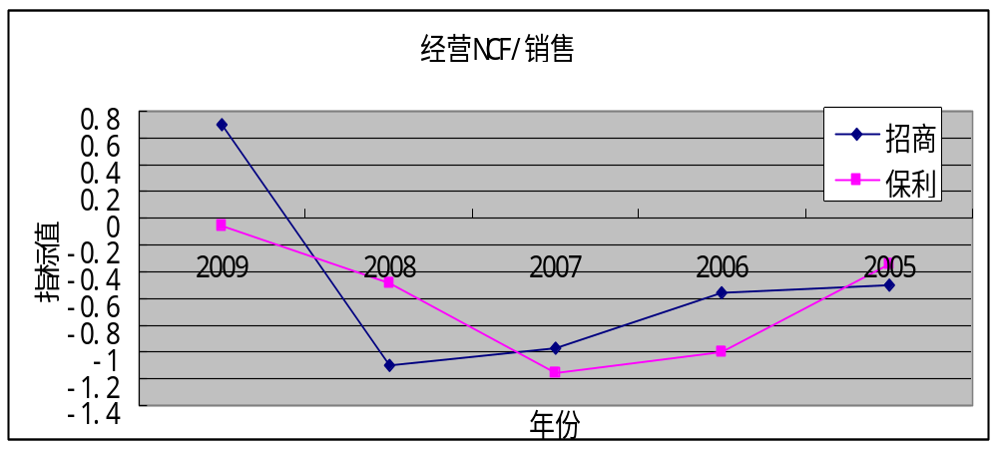
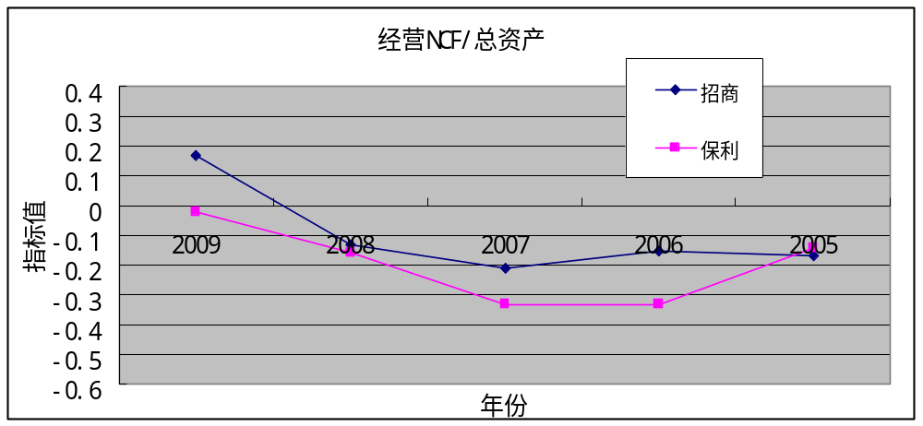
四、收益、风险、成长和价值创造的分解分析
4、现金创造能力分析：

Slide 35
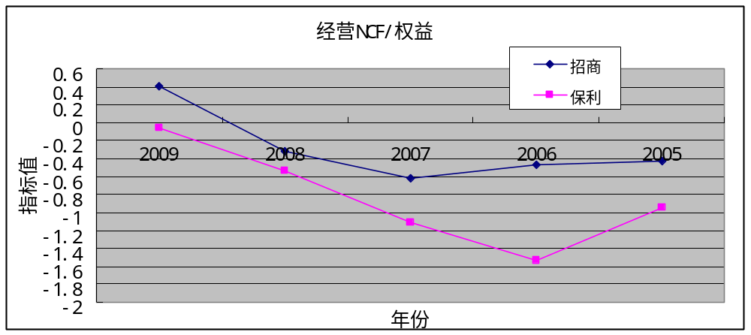
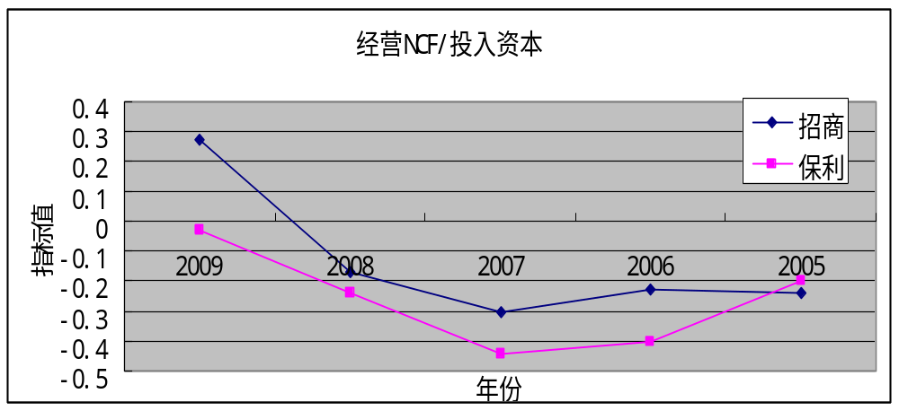
四、收益、风险、成长和价值创造的分解分析

Slide 36
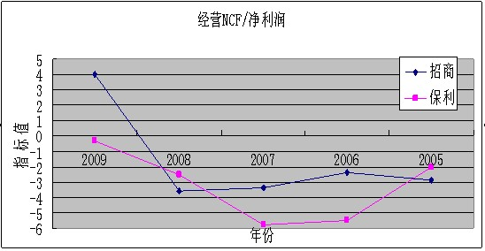
四、收益、风险、成长和价值创造的分解分析
从总体上看，二家公司现金创造能力都是先抑后扬的趋势。
对比二家公司，尽管保利地产公司在销售收入、资本、总资产、利润等财务表现上要远远超过招商地产，但反映在现金创造能力上的表现，却是招商地产优于保利地产。说明招商地产主要动用自身经营现金流入来支持企业的可持续发展，而保利地产更多地运用筹资活动，来帮助企业发展壮大，体现在报表上，保利地产的有息负债接近于招商地产的2.5倍。

Slide 37
四、收益、风险、成长和价值创造的分解分析
主要原因:
是基于二家企业对未来房地产市场形势判断的不同，以及依此采取的策略也有所不同。
作为地产公司，招商地产和保利地产均对房地产后市发展看好，通过不断取得储备地块，增加可开发的建筑面积，来提高公司的可持续发展能力;
但招商地产更愿意采取偏于保守策略，现金流出控制在超过自身经营收入的一定比例范围内；
而保利地产，则更愿意激进些，更愿意通过筹资活动取得企业发展壮大的现金支持，通过储备更多的土地，开发和销售更多的楼房，来扩大企业规模。

Slide 38
四、收益、风险、成长和价值创造的分解分析
招商地产从2005年至2008年，EBIT利润率逐年上升，从0.209上升到0.373，2009年降为0.223；保利地产EBIT利润率基本保持稳定，处于0.23－0.27的区间。
招商地产从2005年至2008年，资产周转次数逐年下降,从0.333下降到0.114，2009年升为0.238；保利地产资产周转次数除了2007年为0.283外，其余都在0.3以上,波动不是太大。从两个公司比较看，保利地产资产周转次数高于历史同期招商地产的资产周转次数。
5、ROE和自我可持续增长率g及其影响因素指标分析：
ROE及其影响因素 | 2005年 |  | 2006年 |  | 2007年 |  | 2008年 |  | 2009年
 | 招商 | 保利 | 招商 | 保利 | 招商 | 保利 | 招商 | 保利 | 招商 | 保利
ROE | 0.145 | 0.464 | 0.196 | 0.281 | 0.186 | 0.193 | 0.086 | 0.214 | 0.101 | 0.188
EBIT/销售收入 | 0.209 | 0.273 | 0.285 | 0.259 | 0.356 | 0.292 | 0.373 | 0.257 | 0.223 | 0.231
销售收入/总资产 | 0.333 | 0.387 | 0.274 | 0.329 | 0.219 | 0.283 | 0.114 | 0.328 | 0.238 | 0.320
总资产/权益 | 2.527 | 6.902 | 3.038 | 4.698 | 2.932 | 3.406 | 2.460 | 3.316 | 2.468 | 3.365
税前利润/EBIT | 1.004 | 0.996 | 0.987 | 1.007 | 0.993 | 1.013 | 0.977 | 1.008 | 1.007 | 1.012
税后利润/税前利润 | 0.820 | 0.640 | 0.838 | 0.699 | 0.822 | 0.678 | 0.839 | 0.757 | 0.772 | 0.745
留存收益比例 | 0.804 | 0.893 | 0.981 | 0.978 | 0.958 | 0.947 | 0.843 | 0.894 | 0.902 | 0.937
自我可持续增长率 | 0.117 | 0.414 | 0.192 | 0.275 | 0.178 | 0.183 | 0.072 | 0.191 | 0.092 | 0.176
预计未来增长率 |  |  |  |  |  |  |  |  | 0.047 | 0.116
资金状态 |  |  |  |  |  |  |  |  | 剩余 | 剩余
两个公司总资产/权益从2005年到2009年都有下降的趋势，也就是说资产负债率逐年下降。保利地产的资产负债率高于同期招商地产的资产负债率。
两个公司的利息支付基本上保持一致；保利地产企业所得税高于招商地产企业所得税。

Slide 39
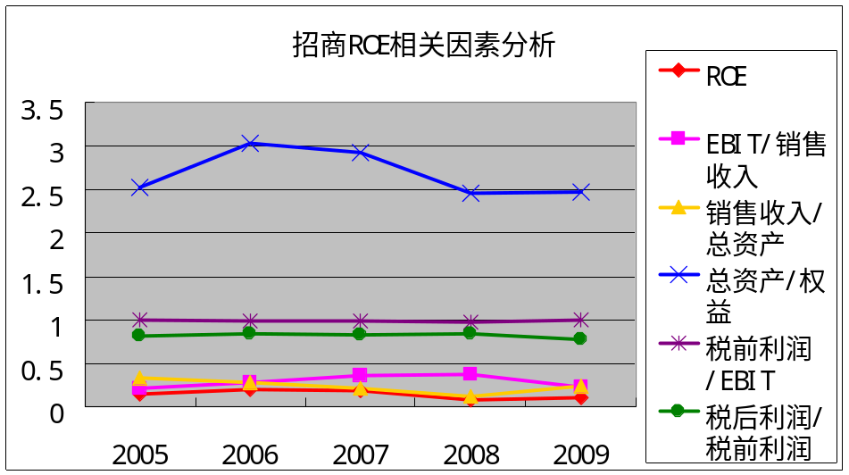
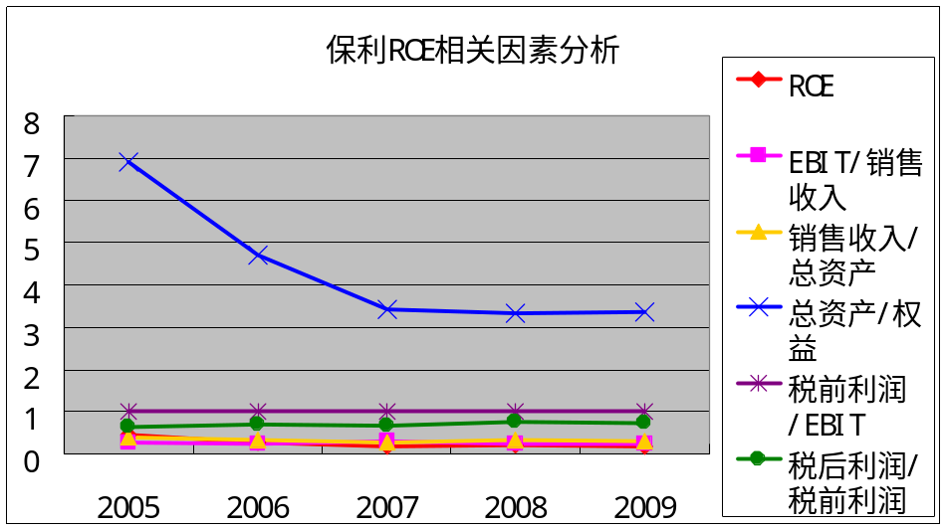
四、收益、风险、成长和价值创造的分解分析
ROE分析结论：
从上面的分析可以看出，资产周转次数、财务杠杆和税收政策是导致保利地产ROE高于同期招商地产ROE的主要原因。

Slide 40
四、收益、风险、成长和价值创造的分解分析
ROE变化的主要原因：
资产的周转次数体现了公司经营管理能力，资产周转次数高说明企业资产资产经营效率和利用效率高，销售能力强。
财务杠杆体现公司的财务管理能力，保利地产高负债，保证了公司高速增长和高的效益；招商地产适度负债，公司业绩优良。
税收效应也是影响ROE的重要原因,税收越高，ROE越低。

Slide 41
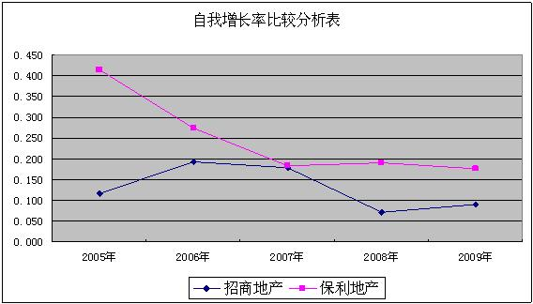
四、收益、风险、成长和价值创造的分解分析
自我可持续增长率与留存收益比例、营业利润率、资产周转率、财务杠杆和税负政策有关。
保利地产相在自我增长率方面比显著的超过招商地产。

Slide 42
四、收益、风险、成长和价值创造的分解分析
2009年，招商地产自我可持续增长率为9.2%，保利地产自我可持续增长率为17.6%；
预估2010年招商地产销售增长率为4.7%，保利地产销售增长率为11.6%；
由于两家公司预计未来增长率大于自我可持续增长率，所以资金状态均为剩余。

Slide 43
四、收益、风险、成长和价值创造的分解分析
6、经营风险和财务风险分析：
风险指标 | 2005年 |  | 2006年 |  | 2007年 |  | 2008年 |  | 2009年
 | 招商 | 保利 | 招商 | 保利 | 招商 | 保利 | 招商 | 保利 | 招商 | 保利
销售收入增长率 | -20.9% | 51.7% | 2.1% | 70.5% | 4.6% | 101.3% | -13.1% | 91.2% | 183.7% | 48.1%
EBIT增长率 | 19.5% | 111.0% | 39.2% | 61.8% | 82.8% | 127.2% | -9.0% | 68.3% | 69.4% | 33.2%
净利润增长率 | 31.7% | 117.4% | 39.9% | 78.6% | 80.3% | 121.9% | -8.6% | 86.9% | 60.7% | 31.7%
经营杠杆 | -1.07 | 0.47 | 0.05 | 1.14 | 0.06 | 0.80 | 1.46 | 1.34 | 2.65 | 1.45
财务杠杆 | 0.62 | 0.95 | 0.98 | 0.79 | 1.03 | 1.04 | 1.05 | 0.79 | 1.14 | 1.05
总杠杆 | -0.66 | 0.44 | 0.05 | 0.90 | 0.06 | 0.83 | 1.52 | 1.05 | 3.03 | 1.52

Slide 44
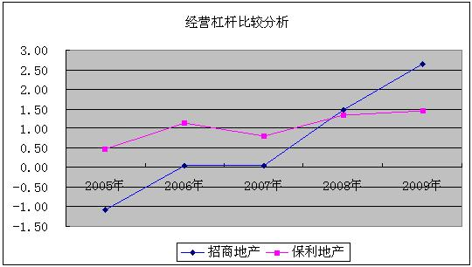
四、收益、风险、成长和价值创造的分解分析
经营风险分析：
两个公司都属于房地产行业，对经济周期变化极为敏感，比如在2008年和2009年初全球金融危机时期，公司销售收入和EBIT都出现了不同程度的下滑，招商地产甚至出现了负增长。

Slide 45
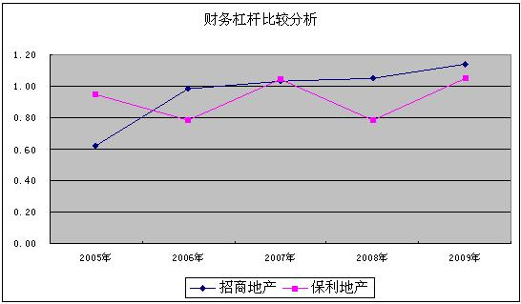
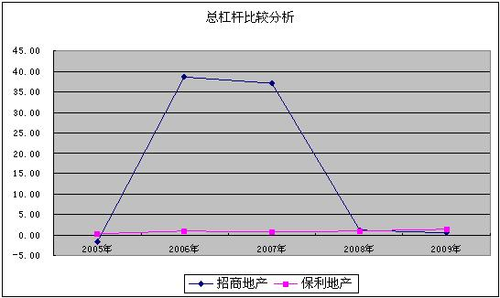
四、收益、风险、成长和价值创造的分解分析
财务风险分析：
两个公司资本结构或者负债的不同引发EBIT或者利息费用的变化，导致企业利润的变化。

Slide 46
四、收益、风险、成长和价值创造的分解分析
风险分析结论：
招商地产与保利地产的主要差距在经营风险上，招商地产的经营风险逐年上升，而保利地产经营风险保持温和增长，最后反映在总杠杆中招商地产波动比较大。
变化的主要原因：
对于招商地产来说，经营风险指标变化的主要原因是销售收入的剧烈波动，要进一步减少经营风险，一方面通过可控因素，尽量在保持销售量的同时，减少销售收入的波动。
对于保利地产来说，财务风险变化的主要原因在利息费用上，要进一步控制财务风险，保持适度的资产负债率，提高净利润在EBIT中的比例。

Slide 47
四、收益、风险、成长和价值创造的分解分析
7、创值能力指标比较分析：
创值能力指标 | 2005 |  | 2006 |  | 2007 |  | 2008 |  | 2009
 | 招商 | 保利 | 招商 | 保利 | 招商 | 保利 | 招商 | 保利 | 招商 | 保利
税后ROIC | 8.32% | 10.08% | 9.58% | 7.24% | 9.13% | 7.61% | 4.94% | 9.72% | 6.68% | 9.22%
投入资本 | 5672952 | 4096159 | 7012308 | 10071575 | 21122005 | 13182305 | 22612178 | 31048995 | 26087883 | 42912725
有息负债/投入资本 | 0.42 | 0.78 | 0.52 | 0.74 | 0.51 | 0.60 | 0.44 | 0.54 | 0.34 | 0.50
债务资本成本Kd= 3年期贷款利率×（1-T） | 4.72% | 3.68% | 5.28% | 4.40% | 6.21% | 5.12% | 4.98% | 4.49% | 4.58% | 4.43%
权益/投入资本 | 0.58 | 0.22 | 0.48 | 0.26 | 0.49 | 0.40 | 0.56 | 0.46 | 0.66 | 0.50
权益资本Ks（取10%） | 10% | 10% | 10% | 10% | 10% | 10% | 10% | 10% | 10% | 10%
WACC | 7.40% | 4.01% | 7.11% | 4.87% | 7.49% | 6.08% | 7.45% | 6.43% | 7.82% | 6.63%
EVA | 52191 | 248423 | 173114 | 238654 | 217068 | 323346 | -567036 | 1022199 | -297586 | 1114609
EVA/营业总收入 | 1.90% | 10.51% | 6.16% | 5.92% | 5.28% | 3.98% | -15.87% | 6.59% | -2.94% | 4.85%
EVA/总资产 | 0.63% | 4.06% | 1.69% | 1.95% | 1.15% | 1.13% | -1.81% | 2.16% | -0.70% | 1.55%
EVA/投入资本 | 0.92% | 6.06% | 2.47% | 2.37% | 1.65% | 1.53% | -2.51% | 3.29% | -1.14% | 2.60%
EVA/权益 | 1.60% | 28.03% | 5.12% | 9.14% | 3.39% | 3.84% | -4.46% | 7.17% | -1.72% | 5.23%

Slide 48
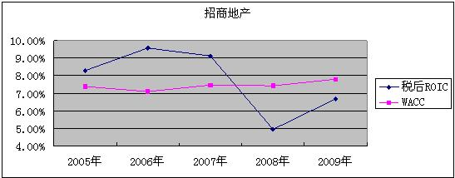
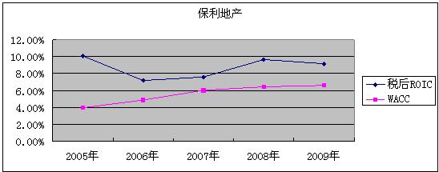
四、收益、风险、成长和价值创造的分解分析
ROIC与WACC的关系：
两家公司从2006年开始，WACC都处于稳步上扬趋势，其中保利地产的WACC上升趋势较快（从05年的4%到09年的6.63%），但总体水平较招商地产低。招商地产的WACC从7%往8%处微步上升。

Slide 49
四、收益、风险、成长和价值创造的分解分析
从税后ROIC来看，都处于震荡变化趋势，但是保利地产的税后ROIC水平变化较缓和，并且都维持在WACC以上。而招商地产波动剧烈，07年之后其税后ROIC水平低于WACC（主要在于08年该水平剧烈下降到不到5%，09年税后ROIC水平开始上升，但仍处于较低水平）。另外，很有意思的是，两家公司从05年到09年的税后ROIC变化方向刚好相反。

Slide 50
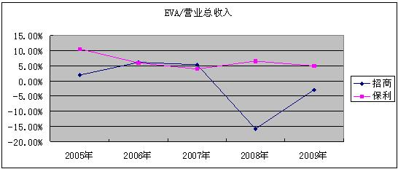
四、收益、风险、成长和价值创造的分解分析
销售的创值能力：
两家公司EVA/营业总收入的变化趋势与其税后ROIC变化趋势一致，说明税后ROIC是主要影响力量。
公司之间，保利地产的波动较小，而招商地产震荡剧烈，并且该数据都落后于保利地产。由此可说明保利地产的销售创值能力较强，并且保持在一个较平稳的水平。

Slide 51
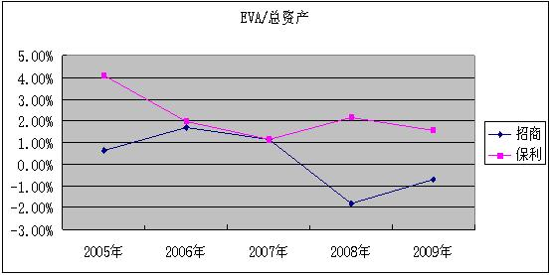
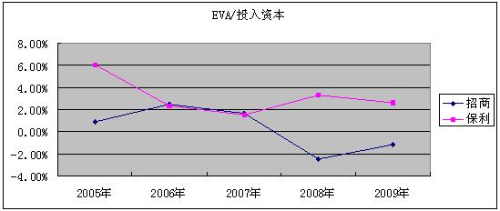
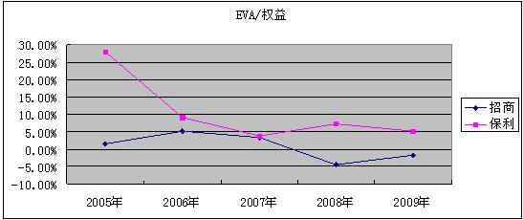
四、收益、风险、成长和价值创造的分解分析
资产和资本的创值能力：
不管是总资产，投入资本或者权益的创值能力，保利地产也是超出招商地产。两者都是波动变化，但是变化趋势却倾向于相反方向。

Slide 52
四、收益、风险、成长和价值创造的分解分析
创值能力的分析结论：
从各个方面看，保利地产的创值能力都要高于招商地产，一方面税后ROIC水平较强，另一方面WACC水平较低。并且从2005年至今保利地产都是属于创值型的公司，而且其变化较缓和，属于持续创值。
反观招商地产，变化剧烈，2008年和2009年其EVA为负，损害了投资者的价值，所幸的是从整体趋势看，09年虽然EVA为负，但比起08年算是有长远进步，最主要的是税后ROIC水平提高了不少。

Slide 53
四、收益、风险、成长和价值创造的分解分析
创值能力变化的主要原因：
以上图形显示EVA是导致变化的主要力量，而税后ROIC又是引起EVA变化的关键。
从报表看，招商地产08年的营业收入比07年下降538460000元，而营业成本、三大费用等反而增加了 131882200 元。
在年报中，我们找不到足够的数据揭示变化的原因。

Slide 54
大纲
一、公司概况
二、主要财务数据
三、财务指标的“三维”分析
四、收益、风险、成长和价值创造的分解分析
五、财务政策评价和比较分析
六、总体建议

Slide 55
五、财务政策评价和比较分析
招商地产 | 保利地产
负债政策分析： 较高负债率，短期借款占比较高 | 负债政策分析： 高负债率，长期负债占比相对较高
股利政策分析： 每年坚持现金分红方式，早期分红波动性较大，近三年来十分稳定；送转股本方式较少 | 股利政策分析： 现金分红不高，但坚持转增送配股本
营运资本管理政策分析： 流动比和速动比较好，现金创造能力较强，应收款较高 | 营运资本管理政策分析： 运用无息流动负债经营的能力较强，筹资现金运用较多，资本成本较低
投资政策分析： 主要投资房地产相关行业，如物业管理、园区供电供水、房产中介等，围绕主业 | 投资政策分析： 围绕主业投资房地产项目和公司

Slide 56
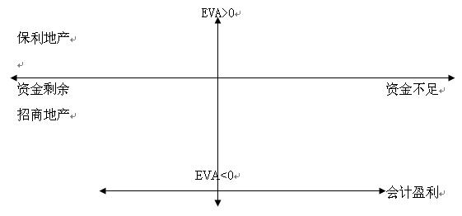
五、财务政策评价和比较分析
保利地产近5年来的EVA均是正数，显示企业近年来一直是创值企业，同时虽然经营性现金流一直是负数，但通过巨额的筹资现金流入，企业的资金也处于快速增长，剩余的状态，同时近5年一直保持盈利，因此在战略矩阵中，保利地产处于上图的第二象限，即EVA>0、资金剩余、会计盈利。
招商地产2008、2009年的EVA均是负数，显示在这两年企业是损值企业，但由于2008年筹资现金的增加和2009年经营性现金流的正增长，企业的资金处于连续增长、剩余的状态，同时近5年一直保持盈利，因此在战略矩阵中，招商地产处于上图的第三象限，即EVA<0、资金剩余、会计盈利。

Slide 57
大纲
一、公司概况
二、主要财务数据
三、财务指标的“三维”分析
四、收益、风险、成长和价值创造的分解分析
五、财务政策评价和比较分析
六、总体建议

Slide 58
六、招商地产总体建议
负债政策建议：
适当降低资产负债率，调整负债结构，适度增加长期负债；
股利政策建议：
继续适当分红模式，分配剩余现金；
营运资本管理政策建议：
提高资产管理效率，扩大市场份额，提高ROIC，检讨和优化资本结构，降低WACC；
投资政策建议：
除房地产主业外，适当多元化，降低政策和宏观环境风险，提高抵御外部风险能力。

Slide 59
六、保利地产总体建议
负债政策建议：
优化负债结构，适当降低资产负债率，减少银行贷款所占比重，防止财务风险；
股利政策建议：
增加现金分红，可考虑回购股份，减少送配；
营运资本管理政策建议：
提高销售的现金创造能力，增强还本付息能力，提高现金对本息的保障程度；
投资政策建议：
除房地产主业外，适当多元化，降低政策和宏观环境风险，提高抵御外部风险能力。

Slide 60
特别感谢吴世农教授的指导！
分析结束，谢谢观看！

